Slide 1
Session 4

Slide 2
Bio Python
Biopython is the largest bioinformatics package for python and it’s the most popular
For computational molecular biology
It contains a number of different sub-modules for common bioinformatics tasks.it is
Developed by chapman and chang,mainly written in python.it also contain c code to
Optimize the complex computation part of the software . It runs on windows,linux,
Mac OS ,etc.
Basically,Biopython is a collection of python modules that provide functions to deal
With DNA ,RNA and Protein Sequence.
It can do some operations such as reverse complementing of a DNA string
It provides lot of parsers to read all major genetic databases like GenBank,SwissPort,
FASTA,etc. ,as well as wrappers/interfaces to run other popular bioinformatics
software/tools like NCBI BLASTN,Entrez,etc.

Slide 3
Installation:
You can install Biopython by typing this command in terminals.
Pip install biopython
From Bio.Seq import Seq
From Bio.Seq import Gc
Feature:
Features Biopython is portable, clear and has easy to learn syntax.
Some of the salient features are listed below
● Interpreted, interactive and object oriented.
● Supports FASTA, PDB, GenBank, Blast, SCOP, PubMed/Medline, ExPASy-related formats.
● Option to deal with sequence formats.
● Tools to manage protein structures.
● BioSQL − Standard set of SQL tables for storing sequences plus features and annotations.
● Access to online services and databases, including NCBI services (Blast, Entrez, PubMed)
and ExPASY services (SwissProt, Prosite).

Slide 4
Advantages
Biopython requires very less code and comes up with the following advantages
● Provides microarray data type used in clustering.
● Reads and writes Tree-View type files.
● Supports structure data used for PDB parsing, representation and analysis.
● Supports journal data used in Medline applications.
● Supports BioSQL database, which is a widely used standard database amongst all bioinformatics projects.
● Supports parser development by providing modules to parse a bioinformatics file into a format specific record object or a generic class of sequence plus features.
● Clear documentation based on cookbook-style.
This is a documentation for biopython to know how to import the libraries.
https://biopython.org/wiki/Getting_Started

Slide 5
Goals
The goal of Biopython is to provide simple, standard and extensive access to bioinformatics through python language.
The specific goals of the Biopython are listed below
● Providing standardized access to bioinformatics resources.
● High-quality, reusable modules and scripts.
● Fast array manipulation that can be used in Cluster code, PDB, NaiveBayes and Markov Model.
● Genomic data analysis.

Slide 6
Biology Principles
As we know ,biopython is very important to bioinformatics field.
As biopython is a way to deal with DNA and RNA.
What is DNA?
DNA stands for Deoxyribonucleic acid.
is a herditary material in humans and almost all other organism .every cell in person’s body has same DNA , most DNA located in cell , nucleus, but small amount of DNA can also be found in mitochondria.
Mitochondria: are membrane-bound organelles present in the cytoplasm of all eukaryotic cell and it is responsible for regulating the metabolic activity of the cell.
are structures within the cells that convert energy from food into a form that cell use.

Slide 7
What is RNA?
RNA stands for Ribonucleic acid.
present in all living cells that has structural similarities to DNA.
is a nucleic acid present in all living cells that has structural similarities to DNA. Unlike DNA, however, RNA is most often single-stranded. An RNA molecule has a backbone made of alternating phosphate groups and the sugar ribose, rather than the deoxyribose found in DNA. Attached to each sugar is one of four bases: adenine (A), uracil (U), cytosine (C) or guanine (G).
RNA consists of RRNA → Ribosome RNA
TRNA→ transference RNA
MRNA→Messenger RNA

Slide 8
MRNA:is a type of single-stranded RNA involved in protein synthesis. mRNA is made from a DNA template during the process of transcription. The role of mRNA is to carry protein information from the DNA in a cell’s nucleus to the cell’s cytoplasm (watery interior), where the protein-making machinery reads the mRNA sequence and translates each three-base codon into its corresponding amino acid in a growing protein chain.
TRNA:plays a key role in protein synthesis. Transfer RNA serves as a link (or adaptor) between the messenger RNA (mRNA) molecule and the growing chain of amino acids that make up a protein. Each time an amino acid is added to the chain.
RRNA: molecule in cells that forms part of the protein-synthesizing organelle known as a ribosome and that is exported to the cytoplasm to help translate the information in messenger RNA (mRNA) into protein.

Slide 9
What is the difference between DNA and RNA
DNA
RNA
Doubly strands
Antiparallel helix
Deoxyribose
Found in nuclear and mitochondria
Its lifetime long
Its bases A,C,G,T
Single strand
Hairpin and loops
Ribose
Found in nuclear and cytoplasmic
Its lifetime short
Its bases A,C,U,G

Slide 10
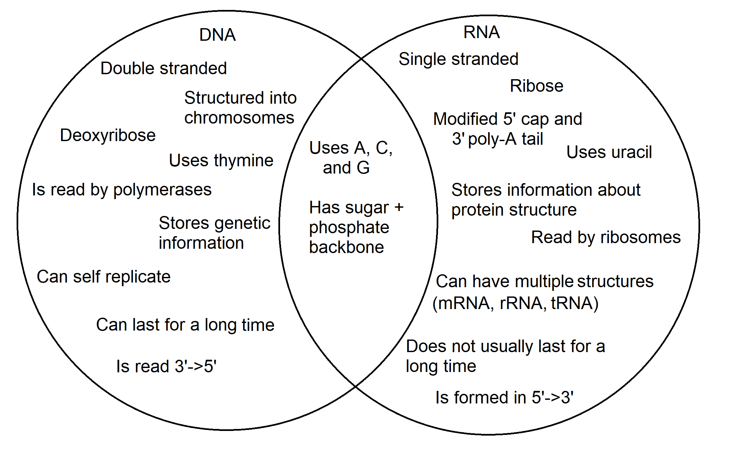

Slide 11
Human DNA consists of about 3 billion bases, and more than 99% of those bases are the same in all people.
■ The order, or sequence, of these bases determines the information available for building and maintaining an organism, similar to the way in which letters of the alphabet appear in a certain order to form words and sentences. DNA bases pair up with each other, A with T and C with G, to form units called base pairs.
■ Each base is also attached to a sugar molecule and a phosphate molecule. To form nucleotide.
■ Nucleotides are a base, sugar, and phosphate, arranged into two long strands that form a spiral called a double helix.
■ The structure of the double helix is somewhat like a ladder, with the base pairs forming the ladder’s rungs and the sugar and phosphate molecules forming the side pieces of the ladder.

Slide 12
Presence and form:
We have so much DNA (2 meters) in each cell) and our nuclei are so small, DNA has to be packaged incredibly neatly. So Strands of DNA are looped, coiled and wrapped around proteins called histones. In this coiled state, it is called chromatin, It is further condensed, through a process called supercoiling, and it is then packaged into structures called chromosomes. These chromosomes form the familiar “X” shape, Each chromosome contains one DNA molecule. Humans have 23 pairs of chromosomes or 46 chromosomes in total.
■ Each length of DNA that codes for a specific protein is called a Gene.
Chromosome 1 is the largest with around 8,000 genes
Chromosome 21 is the Smallest with around 3,000 genes.

Slide 13
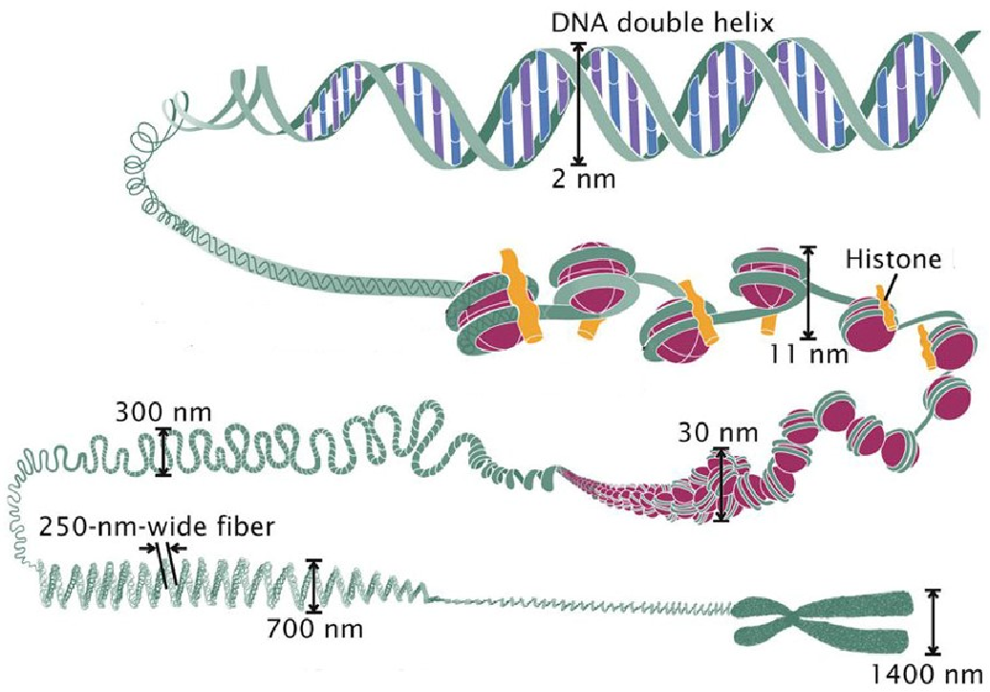
Condensation of DNA

Slide 14
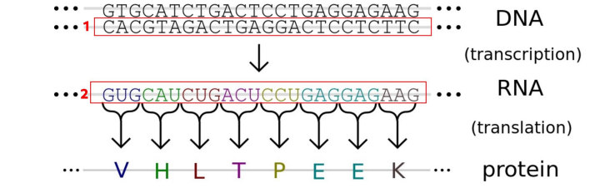
Transcription process: is a process to convert DNA to RNA.
Translation process: is a process to convert RNA to protein.
Note: if I want to make a copy from DNA ,there are an enzymes break the double bonds .
And also there is an enzyme recover each base to its suitable base such as (A→T).
(molecular biology)

Slide 15
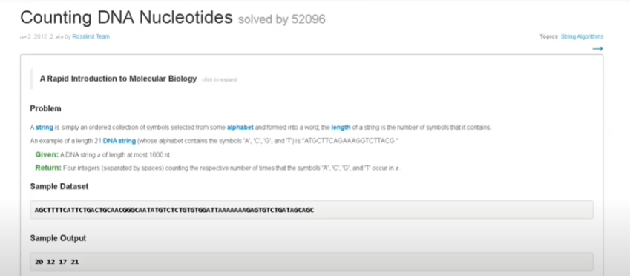

Slide 16
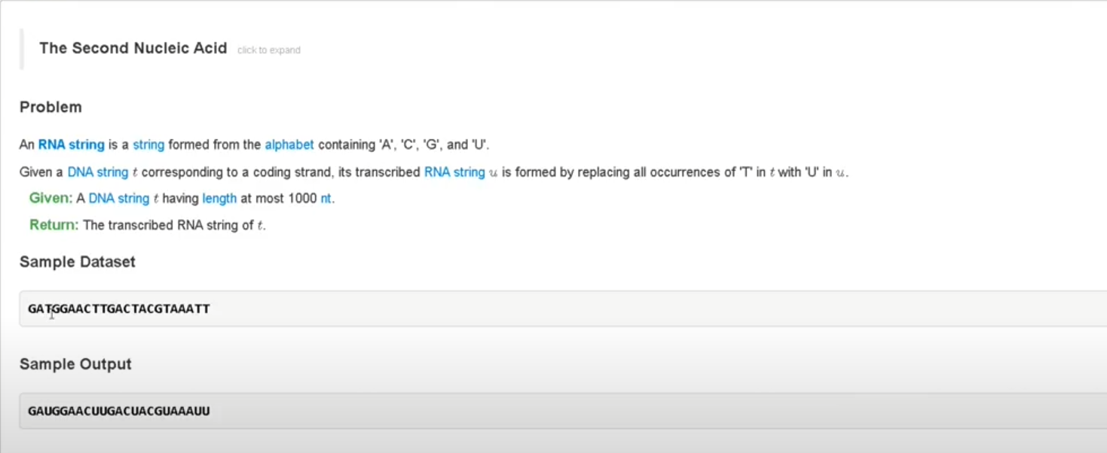

Slide 17
Code:
#using Bio Library
from Bio.Seq import Seq
dataFile = open('rosalind_dna.txt', 'r')
dnaSeq = Seq(dataFile.read())
print(dnaSeq.count('A'), dnaSeq.count('C'), dnaSeq.count('G'), dnaSeq.count('T'))
dataFile.close()

Slide 18
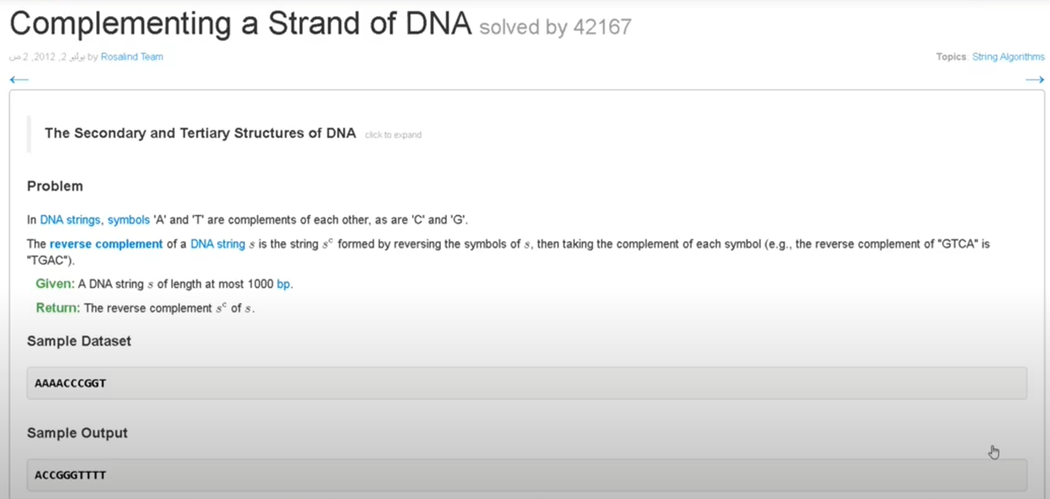

Slide 19
Code:
#using Bio.Seq Library
from Bio.Seq import Seq
dataFile = open('rosalind_revc.txt', 'r')
dnaSeq = Seq(dataFile.read())
dnaComplement = dnaSeq.reverse_complement()
print(dnaComplement)
dataFile.close()

Slide 20

ASSIGNMENT:

